Slide 1

InvestWise
AI-Driven Portfolio Planning Platform
25-26J-445

Slide 2
Problem
Motivation
Financial data is fragmented and difficult to analyze quickly.
CSE Investors lack accessible tools for AI-driven market insight.
Build an AI-powered platform that integrates news sentiment, dividend prediction, financial health, and price prediction to support smarter investment decisions.

Slide 3
Proposed solution overview
An AI-driven investment platform that integrates financial data, news sentiment, and machine learning predictions into a single unified dashboard for retail investors.
Key Features
Open Price Prediction: Automated forecasting of stock opening prices using time-series machine learning ensemble model .
Risk Analysis: AI-powered financial health assessment utilizing Support Vector Regression and Z-Score metrics .
Dividend Prediction: Data-driven forecasting of future payouts utilizing Logistic regression with elastic net regularization.
Sentiment Analysis: Advanced NLP pipeline that evaluates market mood via real-time news scraping and hybrid (Lexicon/ML) analysis.

Slide 4
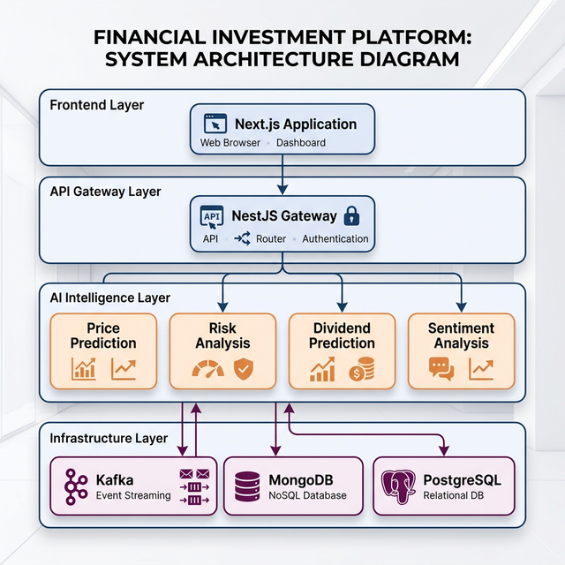
System Architecture & Integration

Slide 5
Commercialization
Target Users / Market
Retail Investors: Access to AI-driven investment insights without expensive institutional tools.
Active Traders: Real-time sentiment analysis for faster trading decisions.
Fintech Startups: Ability to integrate predictive models through API services.
Value Proposition
Holistic Market Intelligence: Combines financial health, news sentiment, and predictive analytics in one platform.
Automated Analysis: Converts large volumes of financial news into actionable insights.
Scalable Architecture: Microservices-based system capable of handling large data streams and concurrent users.

